Slide 1
卷积神经网络-AlexNet模型
深度学习技术讨论会
中国科学院自动化研究所
2017年5月15日

Slide 2
提纲
一、深度学习模型简介
二、卷积神经网络CNN
三、AlexNet
四、参考资料

Slide 3
深度学习模型简介
Deep-learning methods are representation-learning methods with multiple levels of representation, obtained by composing simple but non-linear modules that each transform the representation at one level (starting with the raw input) into a representation at a higher, slightly more abstract level. (Yann LeCun, Yoshua Bengio, Geoffrey Hinton)

Slide 4
常用模型和方法
自动编码器AutoEncoder
稀疏编码Sparse Coding
深度置信网络 DBN与受限波尔兹曼机RBM
卷积神经网络-CNN（Lenet-1986, Alexnet-2012, GoogleNet-2014, VGGNet-2014, Deep Residual Learning-2015）
递归神经网络 RNN 及长短记忆型递归神经网络LSTM
生成对抗网络 GAN
……

Slide 5
开源深度学习框架
库名 | 主语言 | 从语言 | 速度 | 灵活性 | 文档 | 适合模型 | 平台 | 上手难易 | 开发者 | 模式
TensorFlow | C++ | cuda/python/Matlab/Ruby/R | 中等 | 好 | 中等 | CNN/RNN | Linux,OSX | 难 | Google | 分布式/声明式
Caffe | C++ | cuda/python/Matlab | 快 | 一般 | 全面 | CNN | 所有系统 | 中等 | 贾杨清 | 声明式
PyTorch | python | C/C++ | 中等 | 好 | 中等 | - | – | 中等 | Facebook
MXNet | c++ | cuda/R/julia | 快 | 好 | 全面 | CNN | 所有系统 | 中等 | 李沐和陈天奇等 | 分布式/声明式/命令式
Torch | lua | C/cuda | 快 | 好 | 全面 | CNN/RNN | Linux,OSX | 中等 | Facebook | 命令式
Theano | python | c++/cuda | 中等 | 好 | 中等 | CNN/RNN | Linux, OSX | 易 | 蒙特利尔理工学院 | 命令式
……

Slide 6
提纲
一、深度学习模型简介
二、卷积神经网络CNN
三、AlexNet
四、参考资料

Slide 7
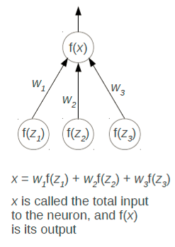
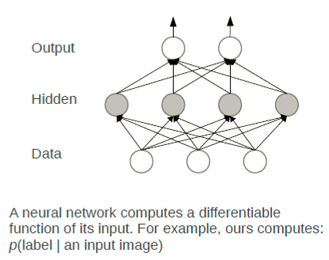
神经网络
A neural network
A neuron

Slide 8
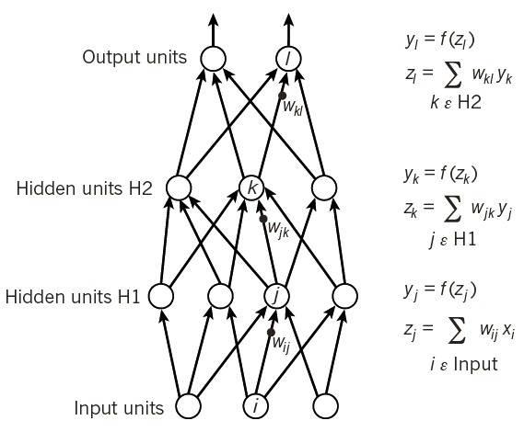
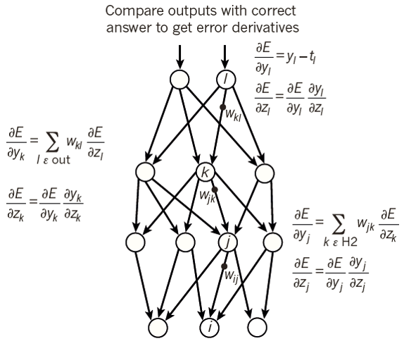
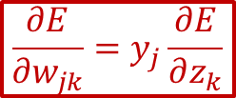
神经网络
Forward pass
Backward pass
$$\frac{∂E}{∂w_{jk}}=y_{j}\frac{∂E}{∂z_{k}}$$
Notes:
已知det(E)/det(Zk)，Zk=sum(wjk*yj)，得det(E)/det(wjk)=det(E)/det(Zk)*det(Zk)/det(wjk)=det(E)/det(Zk)*yj

Slide 9
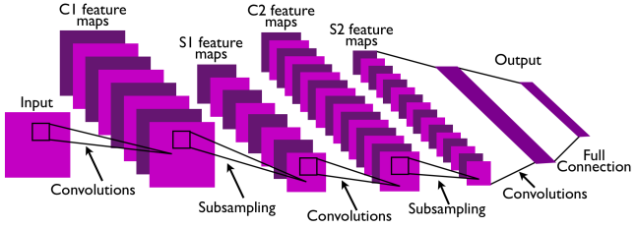
卷积神经网络
Convolutional Neural Network
This is pretty much everything about the convolutional neural network.
Convolution + Subsampling + Full Connection

Slide 10

卷积神经网络
CNNs are basically layers of convolutions followed by subsampling and fully connected layers.
Intuitively speaking, convolutions and subsampling layers works as feature extraction layers while a fully connected layer classifies which category current input belongs to using extracted features.

Slide 11
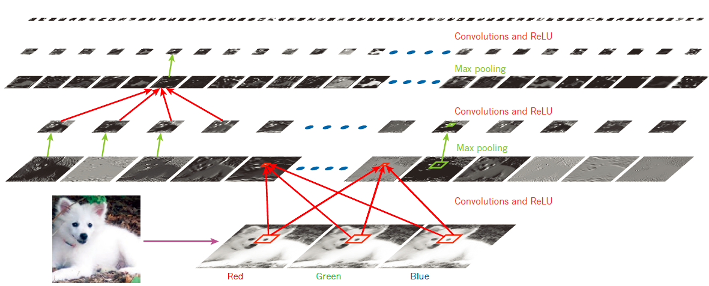
Inside a convolutional network
Local connections
Shared weights
Pooling
Many layers
Notes:
The first few stages are composed of two types of layers: convolutional layers and pooling layers. Units in a convolutional layer are organized in feature maps, within which each unit is connected to local patches in the feature maps of the previous layer through a set of weights called a filter bank. The result of this local weighted sum is then passed through a non-linearity such as a ReLU. All units in a feature map share the same filter bank. Different feature maps in a layer use different filter banks.

Slide 12

Convolution
http://deeplearning.stanford.edu/wiki/index.php/Feature_extraction_using_convolution

Slide 13
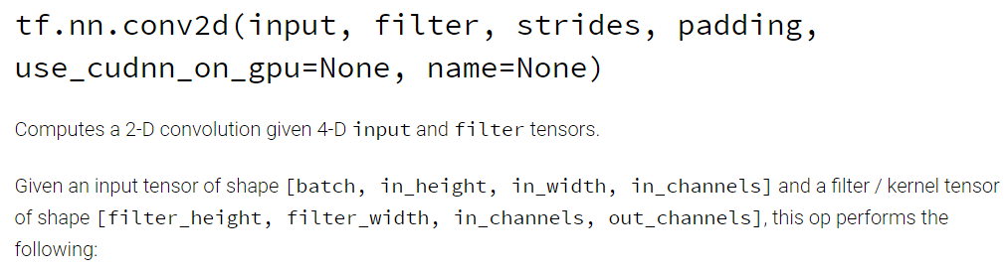
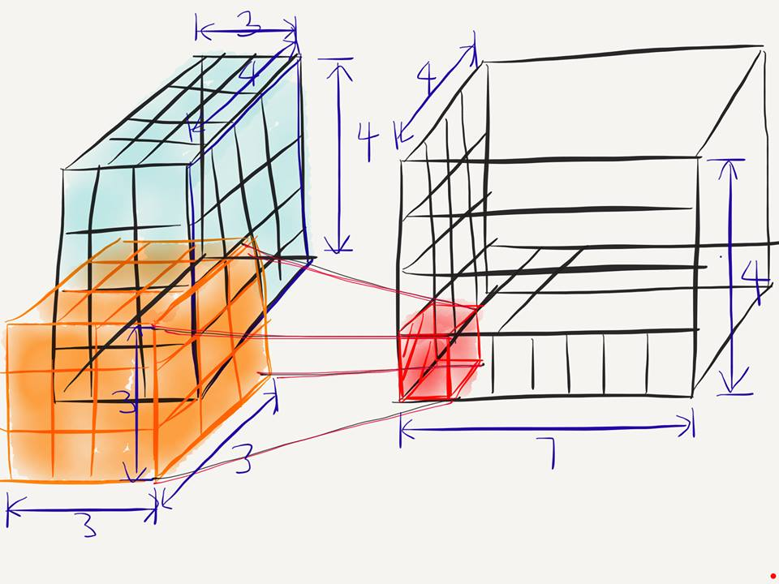
Conv2D
[batch, in_height, in_width, in_channels]
[filter_height, filter_width, in_channels, out_channels]
[batch, in_height=4, in_width=4, in_chnnel=3]
[filter_height=3, filter_width=3, in_channels=3, out_channels=7]
Notes:
out_channels: number of filter

Slide 14
Conv2D
[batch, in_height=4, in_width=4, in_chnnel=3]
[filter_height=3, filter_width=3, in_channels=3, out_channels=7]
What is the number of parameters in this convolution layer?
→ $189= 3∗3∗3∗7$

Slide 15
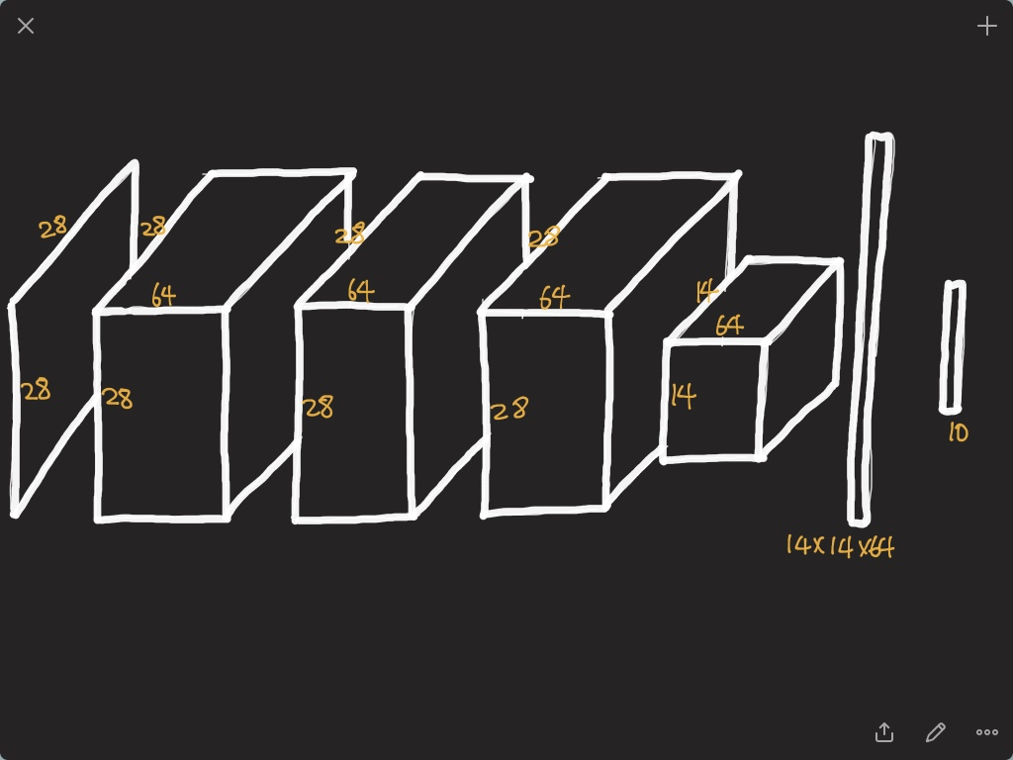

Slide 16
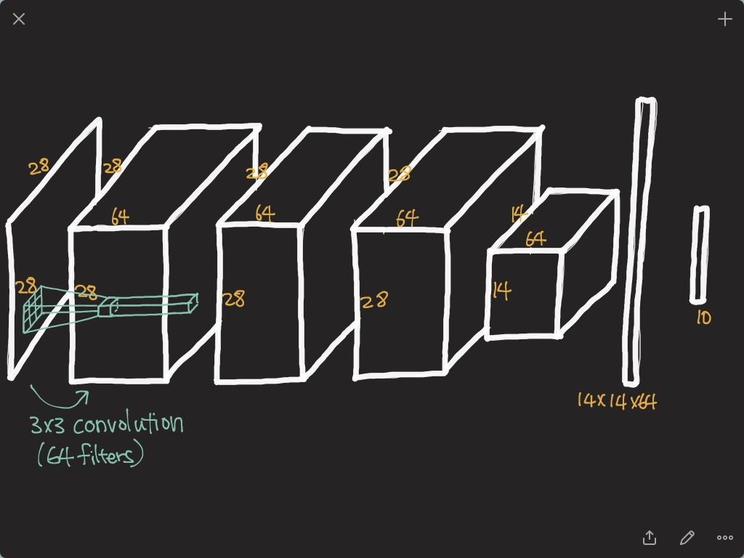

Slide 17
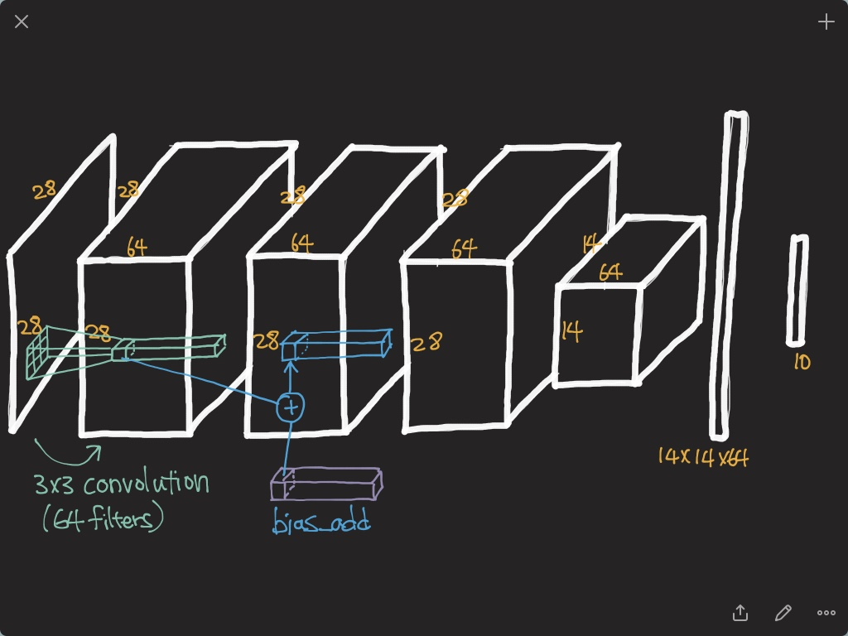

Slide 18
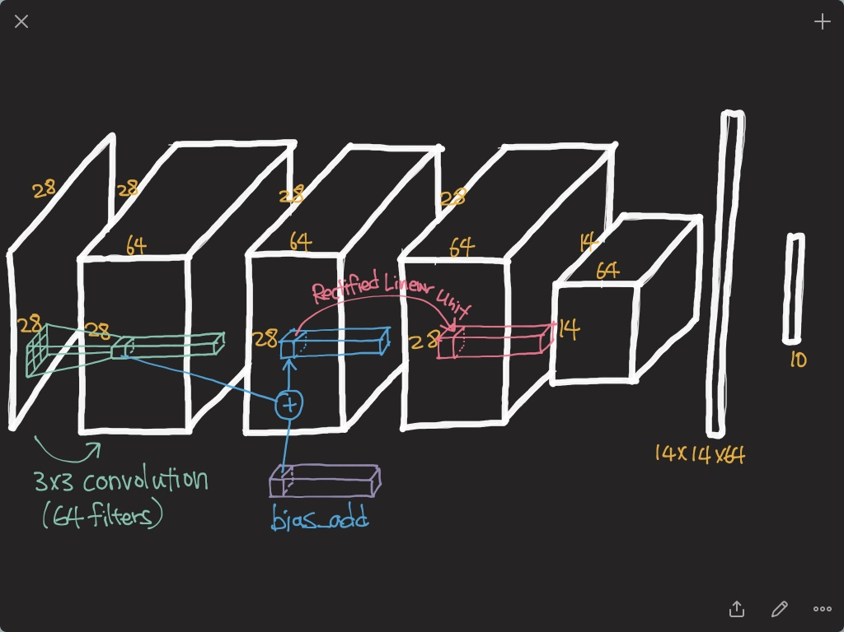

Slide 19
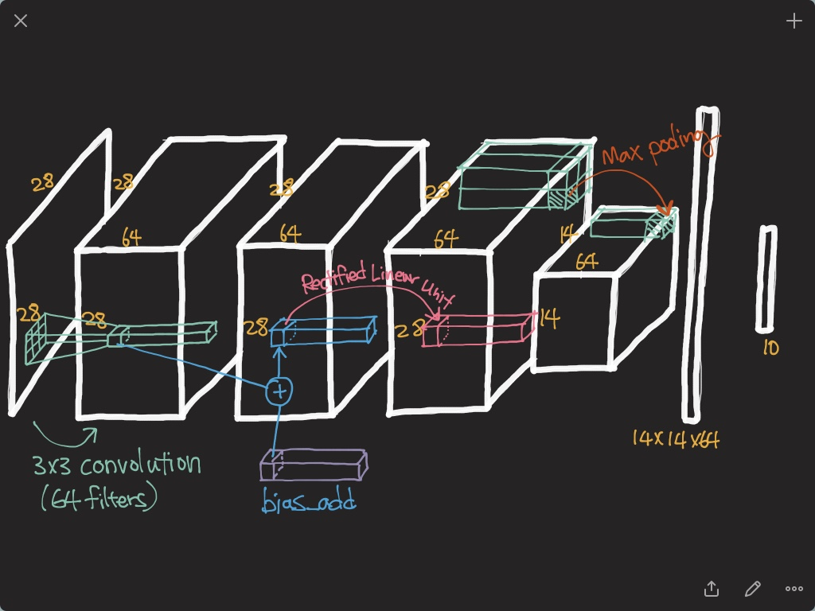

Slide 20
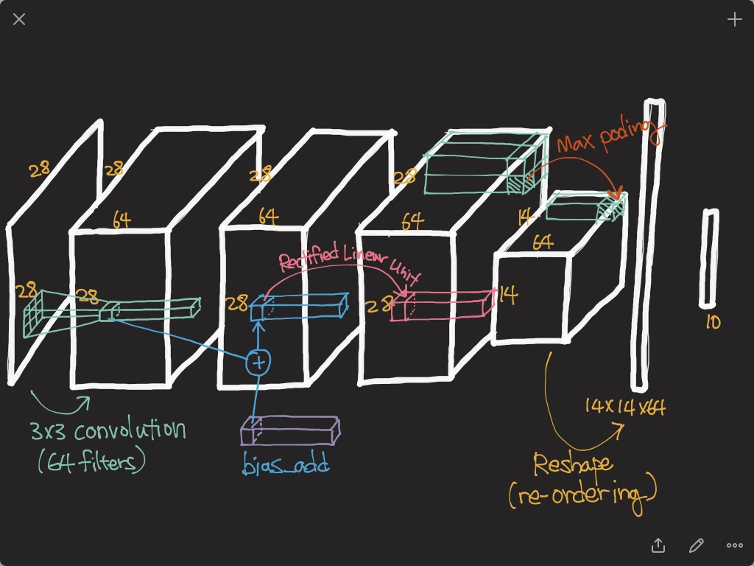

Slide 21
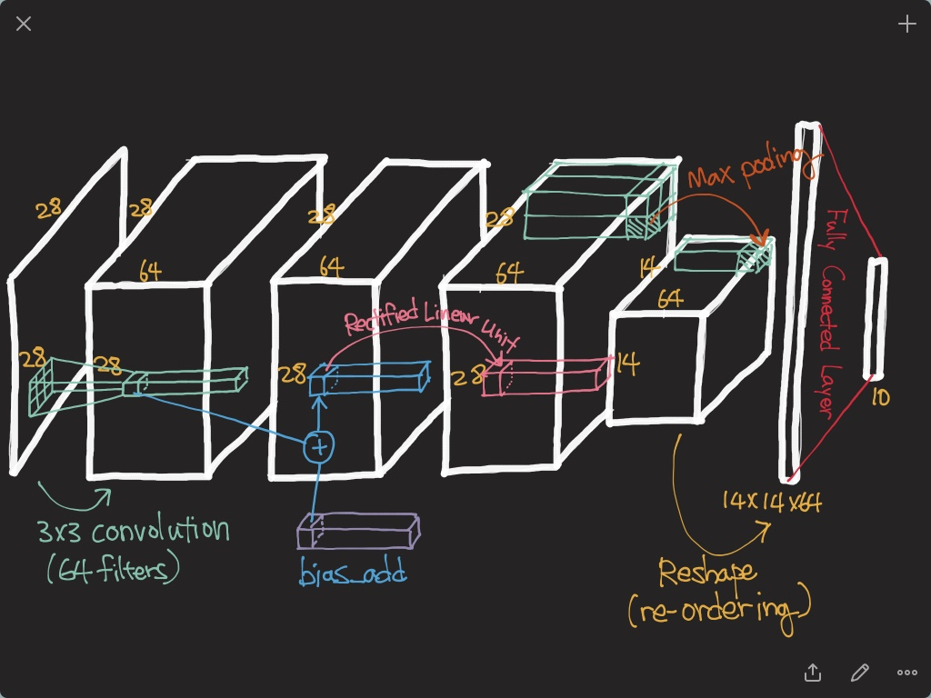

Slide 22
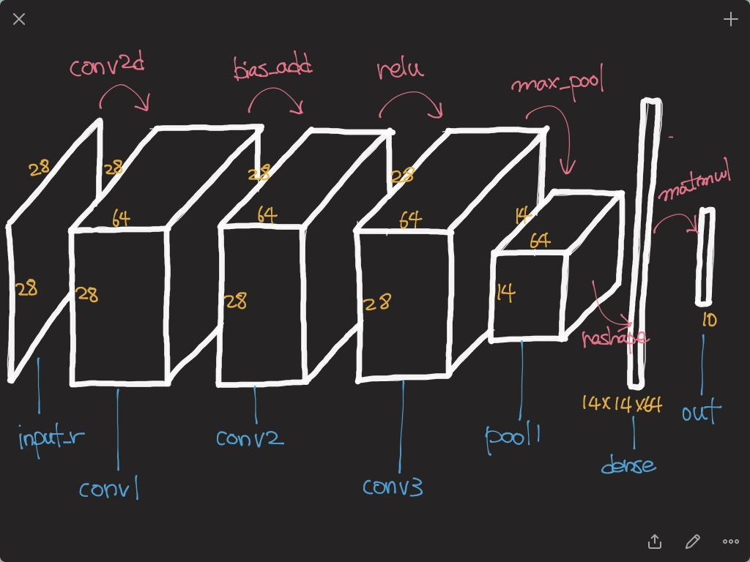

Slide 23
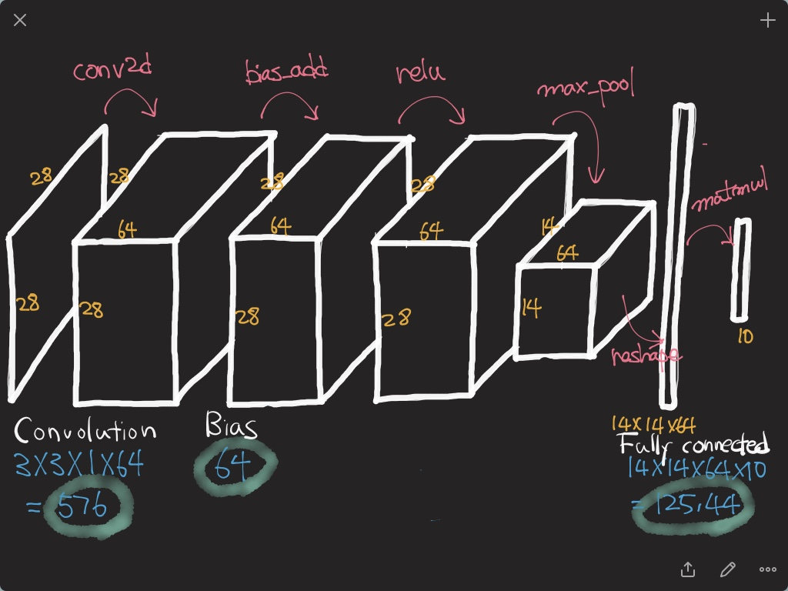

Slide 24
提纲
一、深度学习模型简介
二、卷积神经网络CNN
三、AlexNet
四、参考资料

Slide 25
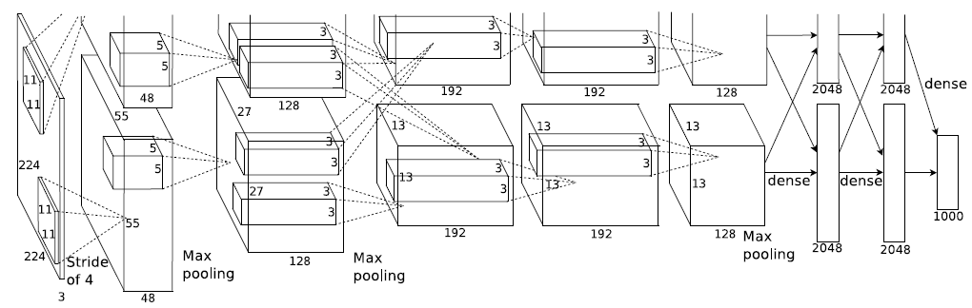

AlexNet
What is the number of parameters?
Why are layers divided into two parts?

Slide 26
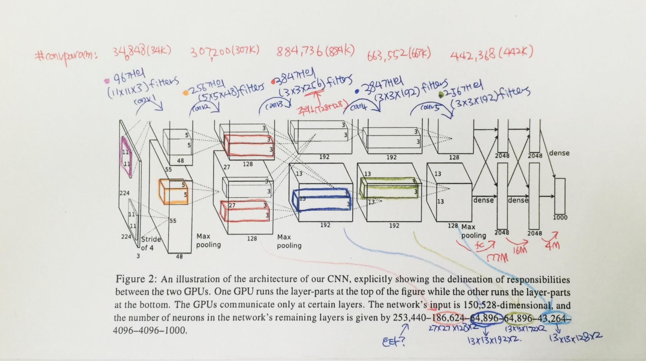
AlexNet
6*6*128*2*4096=37M?

Slide 27
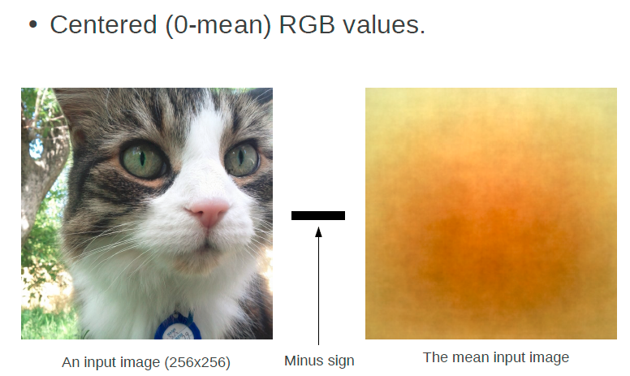
Input representation

Slide 28
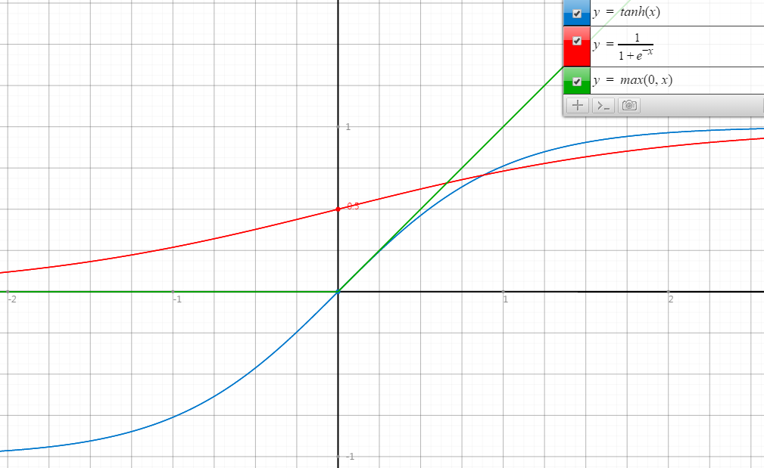
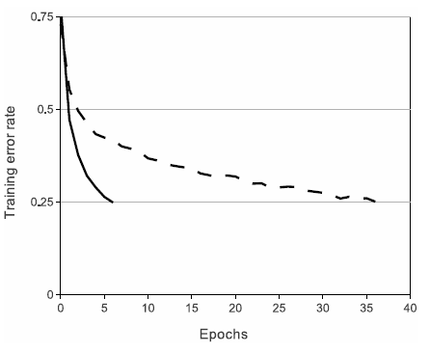
ReLU
Rectified Linear Unit
ReLU
tanh
Faster Convergence!

Slide 29
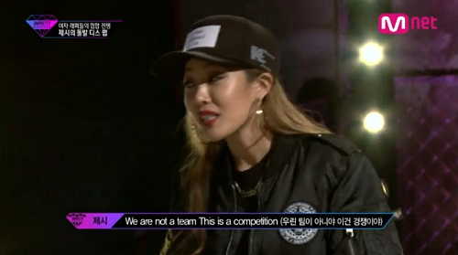
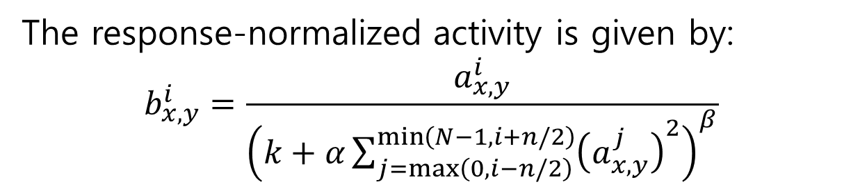
Local Response Normalization
The response-normalized activity is given by:
$$b_{x,y}^{i}=\frac{a_{x,y}^{i}}{{\left(k+α\sum_{j=\max\left(0, i−n/2\right)}^{\min\left(N−1, i+n/2\right)}{{\left(a_{x,y}^{j}\right)}^{2}}\right)}^{β}}$$
It implements a form of lateral inhibition inspired by real neurons.
Reduce the top-1 error rate by 1.4% and top-5 by 1.2%.

Slide 30

Regularization in AlexNet
Main objective is to reduce overfitting.
In the AlexNet, two regularization methods are used.
Data augmentation
Dropout
Notes:
http://scikit-learn.org/stable/auto_examples/model_selection/plot_underfitting_overfitting.html

Slide 31
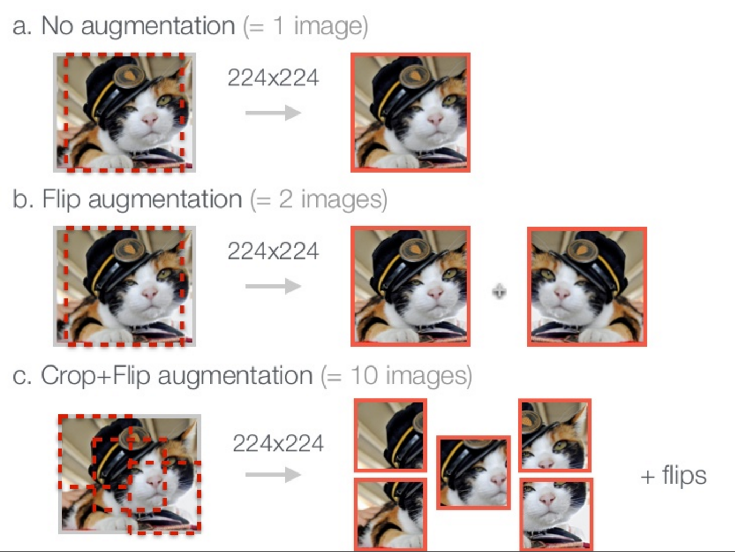
Data augmentation
http://www.slideshare.net/KenChatfield/chatfield14-devil

Slide 32
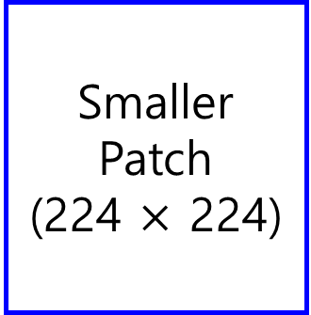

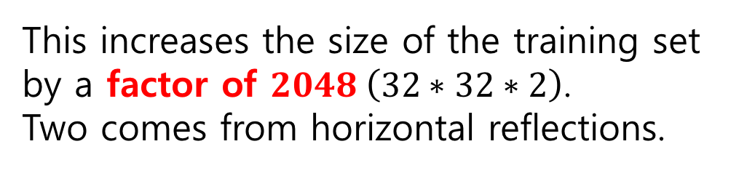
Data augmentation in AlexNet
Original Image
(256 $×$ 256)
Smaller Patch
(224 $×$ 224)
This increases the size of the training set by a factor of $2048 \left(32∗32∗2\right)$.
Two comes from horizontal reflections.

Slide 33
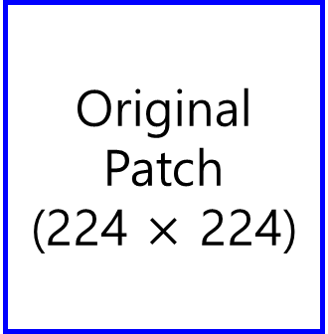
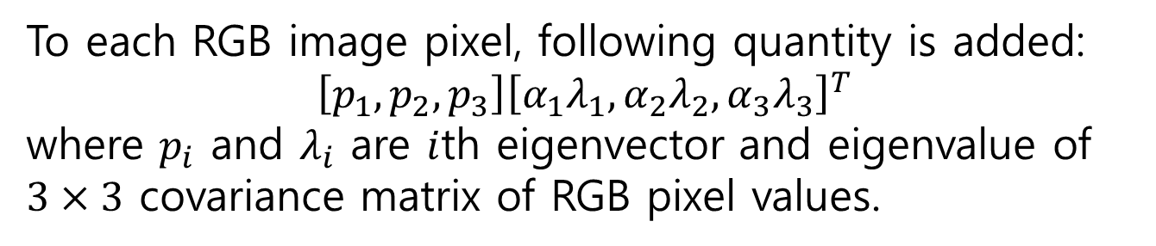
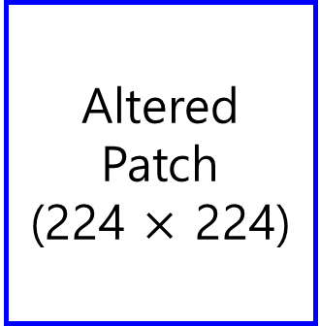
Data augmentation in AlexNet
Original Patch
(224 $×$ 224)
Altered Patch
(224 $×$ 224)
Color variation
To each RGB image pixel, following quantity is added:
$$\left[p_{1}, p_{2}, p_{3}\right]{\left[α_{1}λ_{1},α_{2}λ_{2},α_{3}λ_{3}\right]}^{T}$$
where $p_{i}$ and $λ_{i}$ are $i$th eigenvector and eigenvalue of $3×3$ covariance matrix of RGB pixel values.
Probabilistically, not a single patch will be same at the training phase! (a factor of infinity!)
Reduce the top-1 error rate by 1%

Slide 34
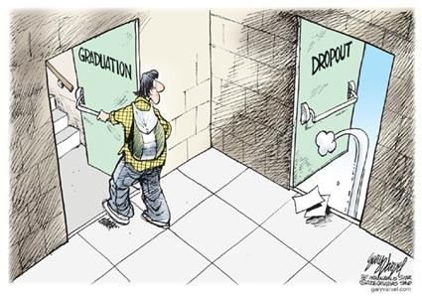
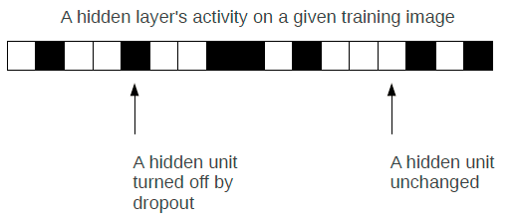
Dropout
Independently set each hidden unit activity to zero with 0.5 probability
Do this in the two globally-connected hidden layers (layer6 and layer7) at the net's output
[1] G.E. Hinton, N. Srivastava, A. Krizhevsky, I. Sutskever, and R.R. Salakhutdinov. Improving neural networks by preventing co-adaptation of feature detectors. arXiv, 2012.

Slide 35
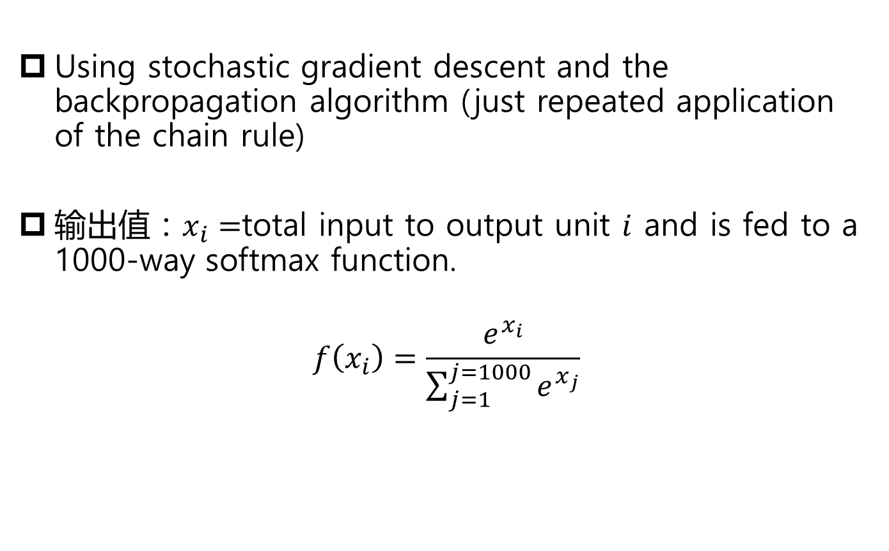
Training
Using stochastic gradient descent and the backpropagation algorithm (just repeated application of the chain rule)
输出值：$x_{i}=$total input to output unit $i$ and is fed to a 1000-way softmax function.
$$f\left(x_{i}\right)=\frac{e^{x_{i}}}{\sum_{j=1}^{j=1000}{e^{x_{j}}}}$$

Slide 36
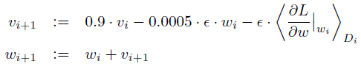
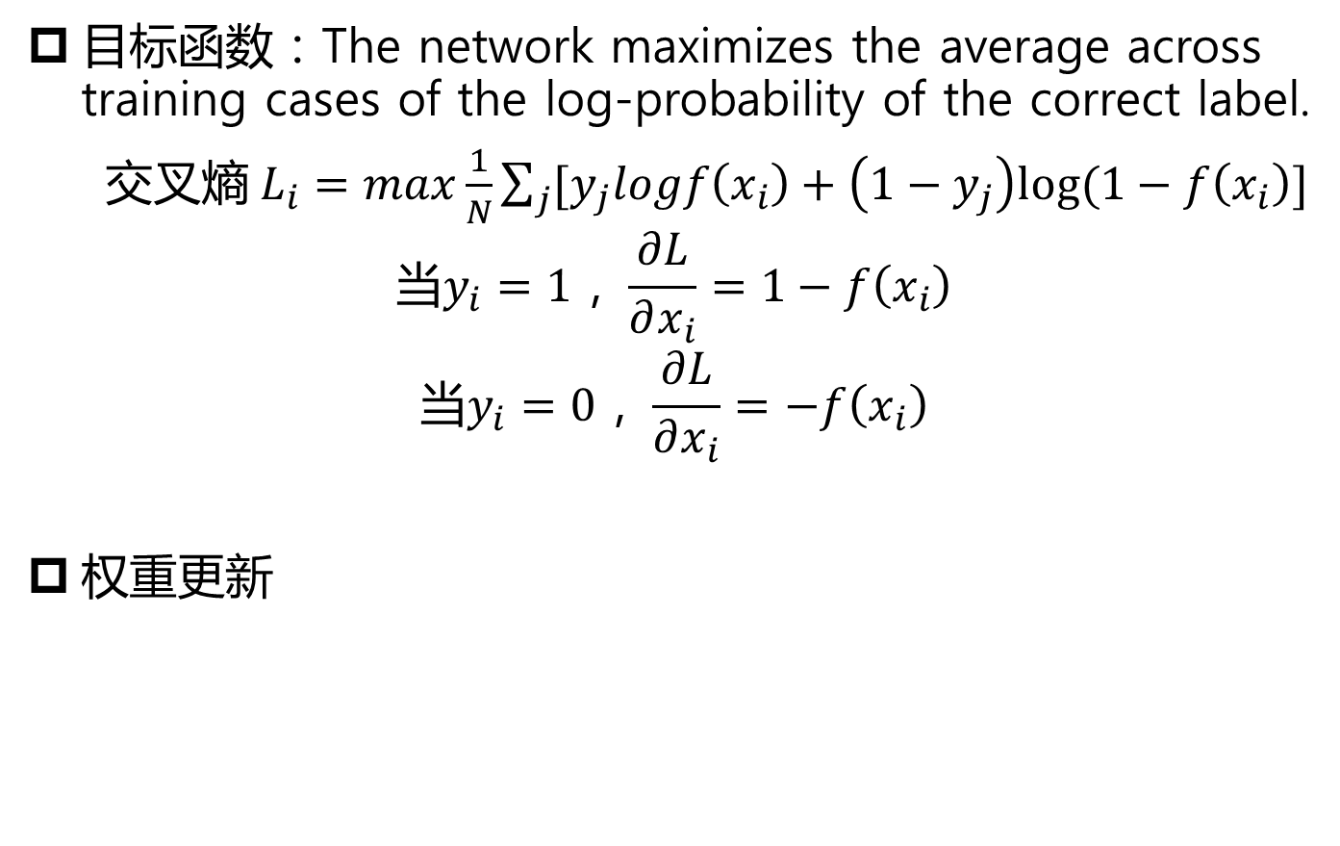
Training
目标函数：The network maximizes the average across training cases of the log-probability of the correct label.
交叉熵$L_{i}=max\frac{1}{N}\sum_{j}{[y_{j}logf\left(x_{i}\right)+\left(1−y_{j}\right)log⁡(1−f\left(x_{i}\right)]}$
$$当y_{i}=1，\frac{∂L}{∂x_{i}}=1−f\left(x_{i}\right)$$
$$当y_{i}=0，\frac{∂L}{∂x_{i}}=−f\left(x_{i}\right)$$
权重更新

Slide 37
AlexNet实验结果
ImageNet数据集（ImageNet Large-Scale Visual Recognition Challenge，ILSVRC）
Totally 15million images，22000 categories
ILSVRC-2010:1.2million for training, 50k for validation, 150k for testing，1000 categories
评价指标（ Error Rate ）
Top-1 error rate
Top-5 error rate
Therefore only 27GB of disk storage is needed to train this system.
Uses about 2GB of RAM on each GPU, and around 5GB of system memory during training.

Slide 38
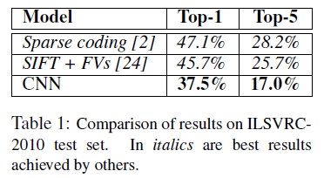
AlexNet实验结果
[2] A. Berg, J. Deng, and L. Fei-Fei. Large scale visual recognition challenge 2010. www.imagenet.org/challenges. 2010.
[24] J. Sánchez and F. Perronnin. High-dimensional signature compression for large-scale image classification. In 2011 IEEE Conference on Computer Vision and Pattern Recognition (CVPR), pages 1665–1672. 2011.

Slide 39
AlexNet实验结果
Off-center
object

Slide 40
AlexNet实验结果(Image Rerieval)
4096维特征+欧式距离
Notes:
4096维特征+欧式距离

Slide 41
提纲
一、深度学习模型简介
二、卷积神经网络CNN
三、AlexNet
四、参考资料

Slide 42
参考资料
LeCun, Yann, Yoshua Bengio, and Geoffrey Hinton. Deep learning. Nature 521.7553 (2015): 436-444.
Krizhevsky, Alex, Ilya Sutskever, and Geoffrey E. Hinton. Imagenet classification with deep convolutional neural networks. Advances in neural information processing systems. 2012.
Alex Krizhevsky, Ilya Sutskever, Geoffrey Hinton. ImageNet Classification with Deep Convolutional Neural Networks. (PPT)
Sungjoon Choi. Introduction to CNNs and AlexNet. (PPT)

